Slide 1
Microprocessor UNIT-1
K.Jayachitra

Slide 2
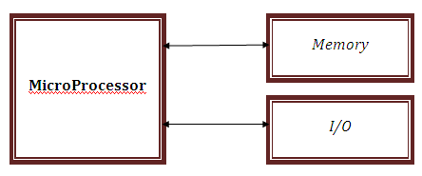
MicroProcessor
Microprocessor (Electronic Device) -
Multipurpose
Programmable
Clock-Driven
Register
Programmable Machine: Represents 3 components

Slide 3
Classification of Microprocessor Applications
Reprogrammable Systems or general purpose microprocessors e.g Microcomputer(Microprocessor is used for computing and data processing, capable of handling large data, mass storage devices).
Embedded Systems-Operations managed behind the scenes by a microcontroller (Microprocessor is the part of final product and not available for reprogramming) e.g copier machine, traffic light controllers, dashboard controllers , dishwashers, washing machines, automatic testing instruments etc.
Microcontroller (MCU)
An integrated electronic computing device that includes three major components on a single chip
Microprocessor (MPU)
Memory
I/O (Input/Output) ports
Microcontrollers have memory etc inside the chip, the busses may all be internal. In the microprocessor the buses are external to the chip (except for the internal data bus). In case of external buses, the chip connects to the busses via buffers, which are simply an electronic connection between external bus and the internal data bus.

Slide 4
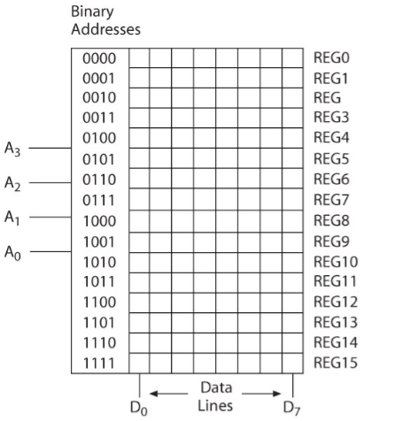
Memory
Like pages of notebook where pages made up of semiconductor material.
Storage Device
Addresses
Registers
Major Categories
Read/Write Memory (R/W)
Read-only-Memory (ROM)

Slide 5
Input/Output (I/O)
Input Devices
Switches , Keypads (Hex, Decimal, ASCII)and analog to digital converter.
Provide binary information to the MPU.
Output devices
LEDs(e.g alphanumeric, 7 segment etc), LCDs, CRTs, printer, X-Y plotter, magnetic tape.
Receive binary information from the MPU.

Slide 6
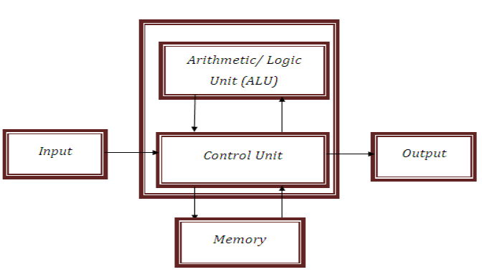
Traditional Block diagram of Computer

Slide 7
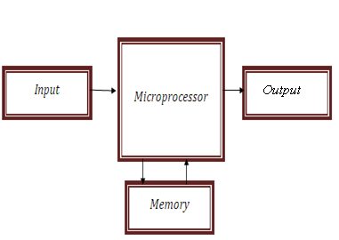
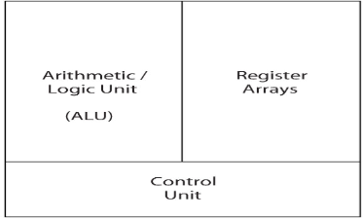
Microprocessor as CPU
MPU (CPU):
Read instructions
Process binary data
Block Diagram of a Computer with Microprocessor as CPU

Slide 8
Semiconductor Technology
End of 1950s; entire circuit consist of several transistors, diodes, and resistors on single chip.
1960’s , logic gates known as 7400 series.
4-bit Microprocessor Intel 4004 the first MP. 4K nibbles address space.
Intel 8008- can manipulate a whole byte.
16Kbytes address space
50,000 operations/second.
Intel 8080’s used for microcomputers
Later versions are Motorola 6800, the Zilog Z80 and the Intel 8085 etc
Motorola 6800 was designed from different Instruction set and architecture from 8080.
Zilog Z80 and the Intel 8085 has upward software compatibility

Slide 9
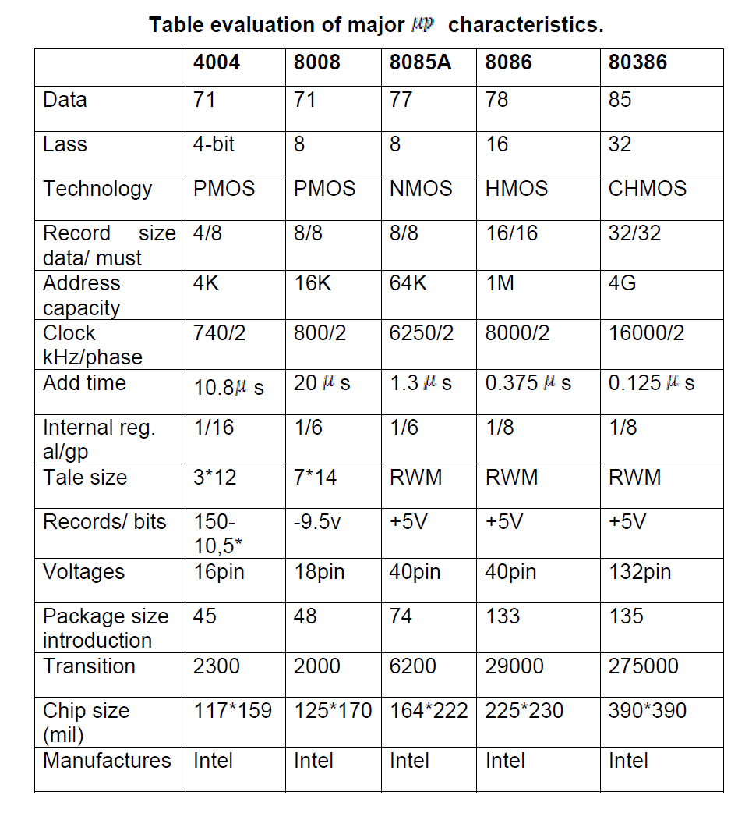

Slide 10
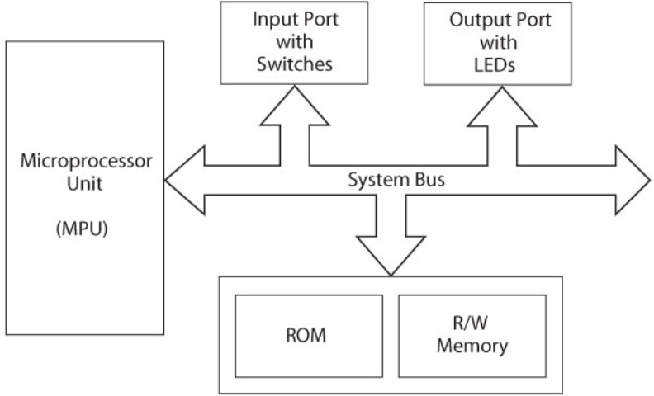
Microprocessor-Based Systems

Slide 11
8085 Microprocessor
Instruction- Binary pattern entered through Input Device to perform specific function.
Made up of one or more words
Instruction Set ( Language)- Various combination of bit patterns
8085 :
has 8-bit word length
2⁸ = 256 words
has 246 bit patterns
has 74 different Instructions (forms Instruction set)
Instruction can be entered using HEX keys.

Slide 12
All the various functions performed by the microprocessor can be classified in three categories
Microprocessor initiated operations
Internal operations
Peripheral (or externally initiated )operations

Slide 13
Microprocessor Initiated Operations
MPU performs four operations
Memory Read : Reads data(or instruction) from memory
Memory Write: Writes data(or instruction) into memory
I/O Read : Accepts data from input devices
I/O Write: Sends data to output devices
Steps to communicate MPU with peripheral(or memory)
Step1: Identify the peripheral or the memory location(with its address)
Step2: Transfer binary Information
Step3: Provide timing and synchronization signal.

Slide 14
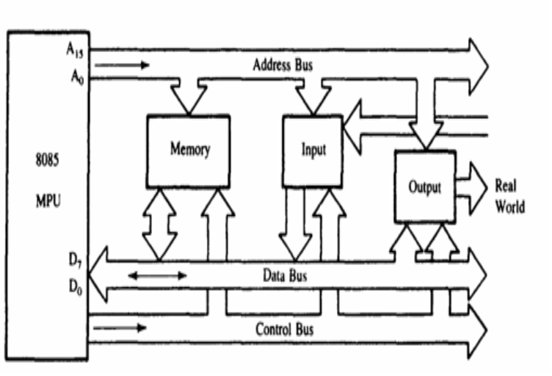
8085 Bus Architecture

Slide 15
Microprocessor Architecture
The MPU communicates with Memory and I/O using the System Bus. Typical system uses a number of buses, collection of wires, which transmit binary numbers, one bit per wire. A typical microprocessor communicates with memory and other devices (input and output) using three busses: Address Bus, Data Bus and Control Bus.
Address bus
Memory and I/O Addresses
One wire for each bit, therefore 16 bits = 16 wires. The Address Bus consists of 16 wires, therefore 16 bits. Its "width" is 16 bits.
A 16 bit binary number allows 2¹⁶ different numbers, ie 0000000000000000 up to 1111111111111111. which can be used.
Address bus is unidirectional, ie numbers only sent from microprocessor to memory, not other way.

Slide 16
Microprocessor Architecture
Data bus
Bidirectional
Transfers Binary Data and Instructions between μP, memory and peripheral devices.
Typical size is 8 or 16 bits. The Data Bus typically consists of 8 wires. Therefore, 2⁸ combinations of binary digits. If only 8 bits wide then largest number is 11111111 (255 in decimal).
The eight data lines enable the MPU to manipulate 8-bit data ranging from 00 to FF (28 = 256 numbers).
Modern day microprocessors, like 80386, 80486 have much larger busses. Typically 16 or 32 bit busses, which allow larger number of instructions, more memory location, and faster arithmetic.

Slide 17
Microprocessor Architecture
Control lines
Read and Write timing signals
Control Bus are various lines which have specific functions for coordinating and controlling microprocessor operations. Eg: Read/Write line, single binary digit. Control whether memory is being ‘written to’ (data stored in mem) or ‘read from’ (data taken out of mem) 1 = Read, 0 = Write.
May also include clock line(s) for timing/synchronising, ‘interrupts’, ‘reset’ etc. Typically microprocessor has 10 control lines.
Cannot function correctly without these vital control signals.
The Control Bus carries control signals partly unidirectional, partly bi-directional.

Slide 18
Internal Data Operation
Internal Architecture determines how and what Operations can be performed with the data?
Store 8-bit data.
Perform arithmetic and logic operations.
Test for conditions.
Sequence the execution of instructions.
Store data temporarily during execution in defined R/W. memory location called stack.
To Perform these operations Microprocessor requires Registers, an ALU and Control logic, and Internal Buses.

Slide 19
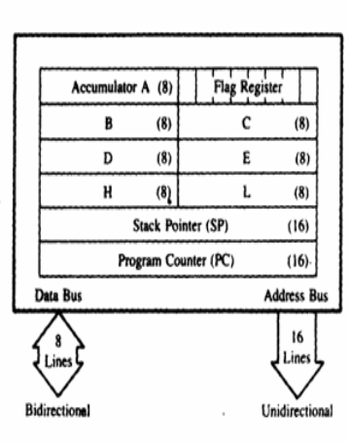
Registers
These registers are identified as B, C, D, E, H, and L.
They can be combined as register pairs-BC, DE, and HL to perform some 16-bit operations.
The 8085 have six general-purpose registers to store 8-bit data during program execution.

Slide 20

Registers
Accumulator (A):
The accumulator is an 8-bit register that is part of the arithmetic/logic unit (ALU).
This register is used to store 8-bit data and to perform arithmetic and logical operations.
The result of an operation is stored in the accumulator.
Flags:
The ALU includes five flip-flops that are set or reset according to the result of an operation.
The microprocessor uses the flags for testing the data conditions.
They are Zero (Z), Carry (CY), Sign (S), Parity (P), and Auxiliary Ca (AC) flags. The most commonly used flags are Sign, Zero, and Carr
The bit position for the flags in flag register is

Slide 21
Registers
1. Sign Flag (S):
After execution of any arithmetic and logical operation, if D7 of the result is 1, the sign flag is set. Otherwise it is reset.
D7 is reserved for indicating the sign; the remaining is the magnitude of number.
If D7 is 1, the number will be viewed as negative number. If D7 is 0, the number will be viewed as positive number.
2. Zero Flag (z):
If the result of arithmetic and logical operation is zero, then zero flag is set otherwise it is reset.
3.Auxiliary Carry Flag (AC):
If D3 generates any carry when doing any arithmetic and logical operation, this flag is set. Otherwise it is reset.
4.Parity Flag (P):
If the result of arithmetic and logical operation contains even number of 1's then this flag will be set and if it is odd number of 1's it will be reset.
5.Carry Flag (CY):
If any arithmetic and logical operation result any carry then carry flag is set otherwise it is reset.

Slide 22
Registers
Program Counter (PC):
This 16-bit register sequencing the execution of instructions.
It is a memory pointer. Memory locations have 16-bit addresses, and that is why this is a 16-bit register.
The function of the program counter is to point to the memory address of the next instruction to be executed.
When an opcode is being fetched, the program counter is incremented by one to point to the next memory location.
Stack Pointer (Sp):
The stack pointer is also a 16-bit register used as a memory pointer.
It points to a memory location in R/W memory, called the stack.
The beginning of the stack is defined by loading a 16-bit address in the stack pointer (register).

Slide 23
Arithmetic and Logic Unit (ALU):
It is used to perform the arithmetic operations like addition, subtraction, multiplication, division, increment and decrement and logical operations like AND, OR and EX-OR.
It receives the data from accumulator and registers.
According to the result it set or reset the flags.

Slide 24
Externally Initiated Operation
External devices can Initiate the following Operations, for which individual pins on microprocessor chip are assigned:
Reset :When reset pin is activates by the external key, all internal operations are suspended and program counter is cleared(0000H). Program execution can again begin at zero memory address.
Interrupt: Microprocessor can be interrupted from normal execution and ask to execute some other instruction (Service routine).
Ready: If the signal at this READY pin is low, the microprocessor enter into this wait state. It is used to synchronize slow peripherals with microprocessor.
Hold: When HOLD pin is activated by an external signal, the microprocessor relinquishes control of buses an allow external peripheral to use them (e. g DMA).

Slide 25
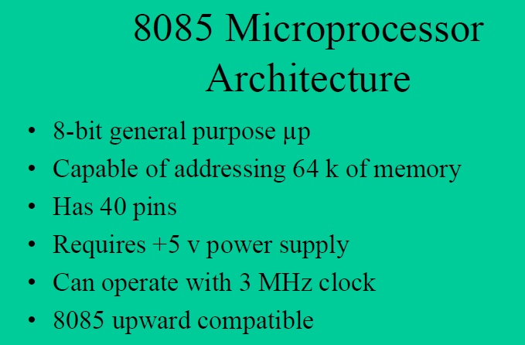

Slide 26
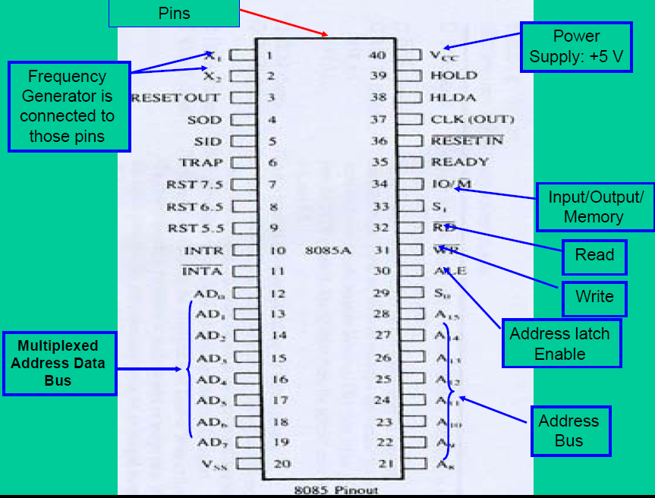

Slide 27
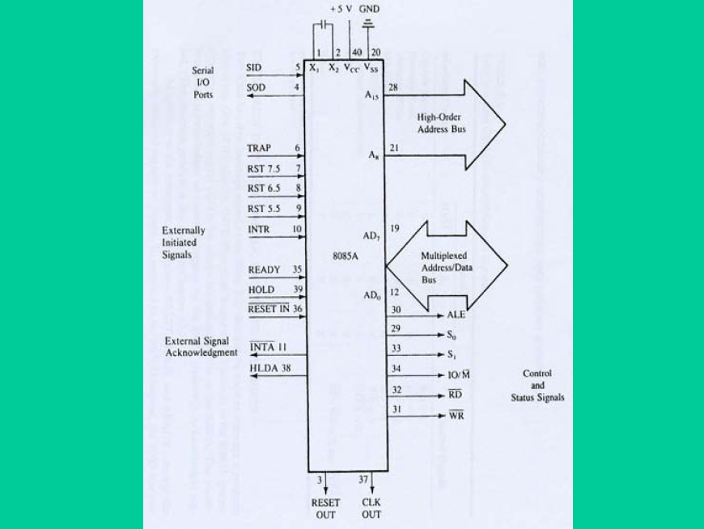

Slide 28
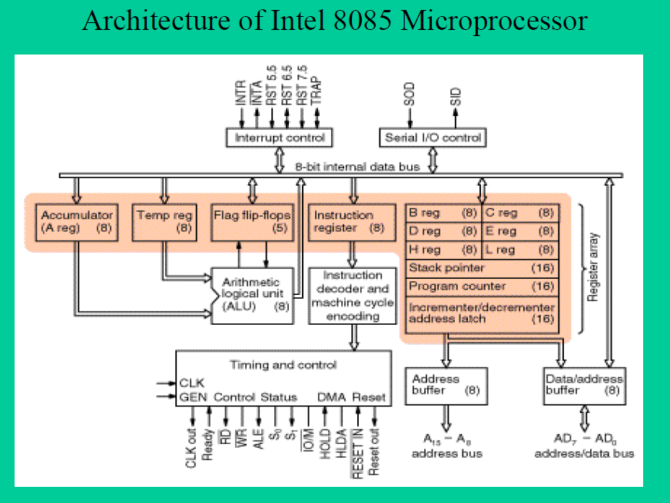

Slide 29
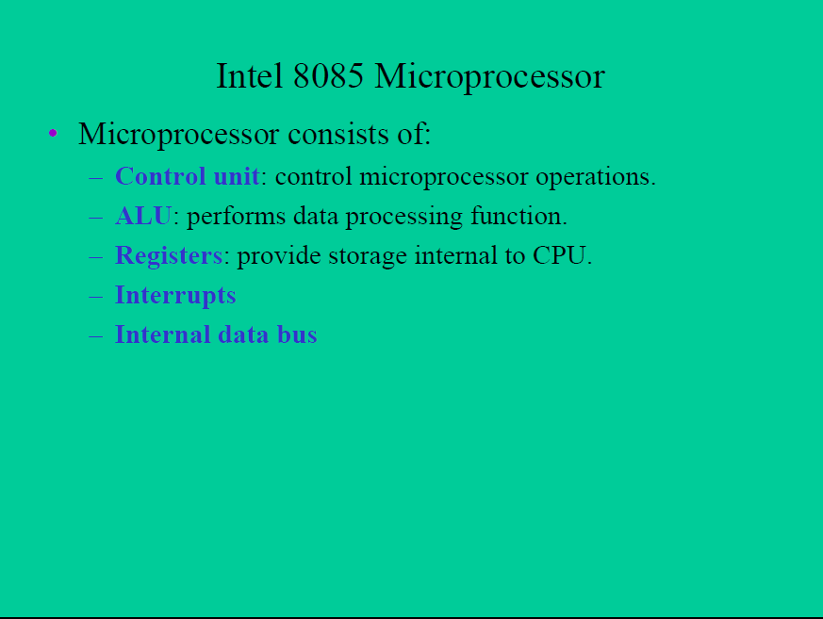

Slide 30
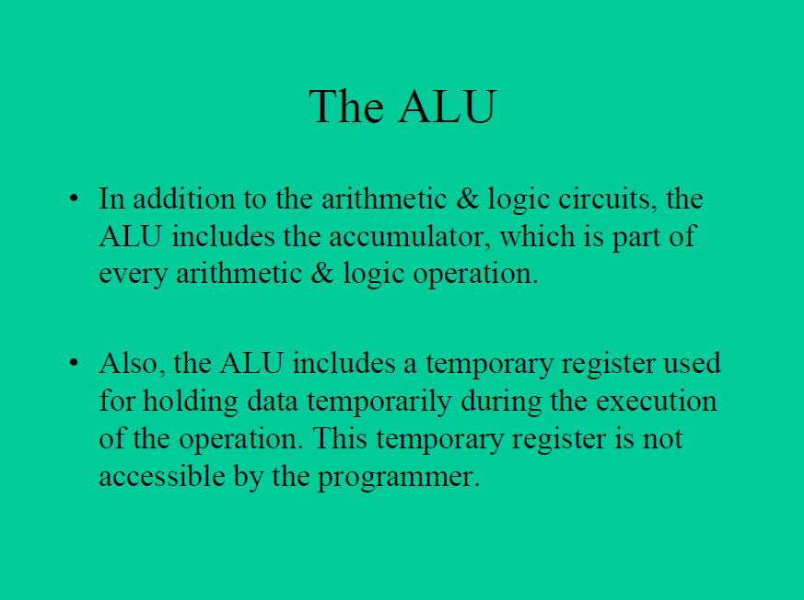

Slide 31
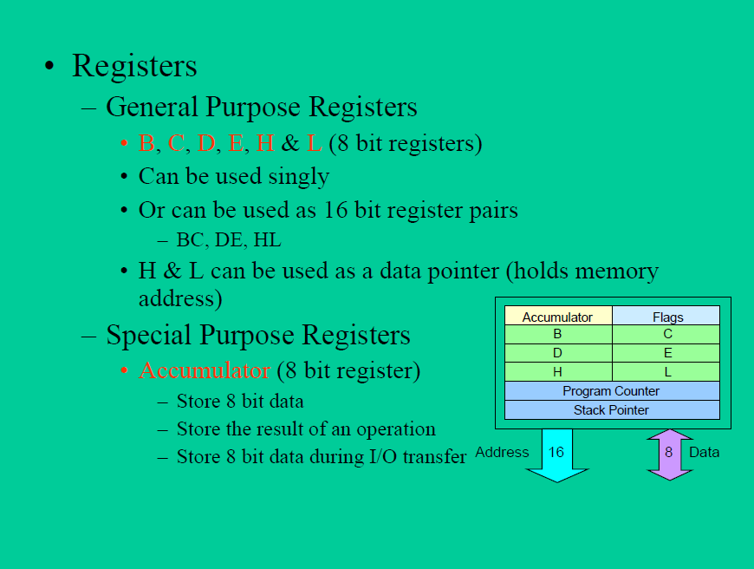

Slide 32
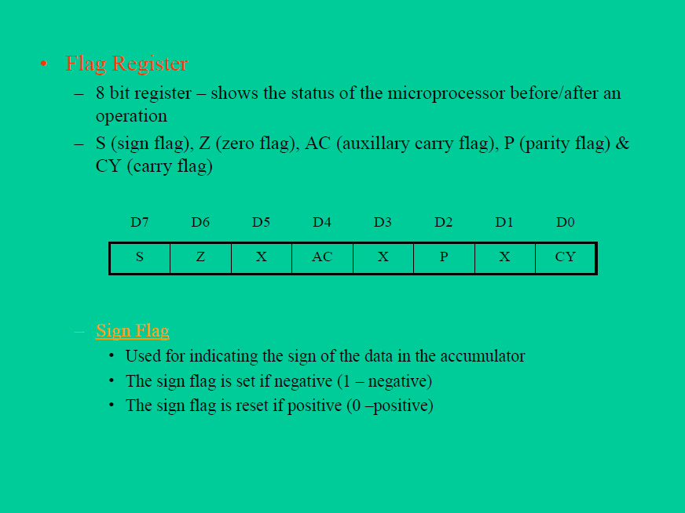

Slide 33
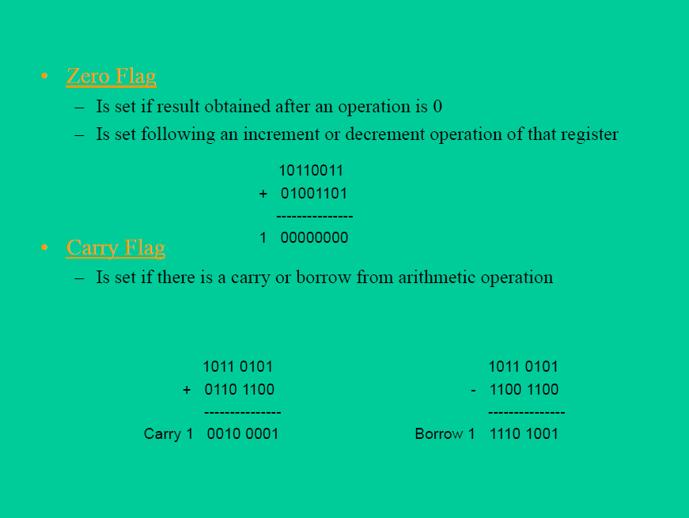

Slide 34


Slide 35
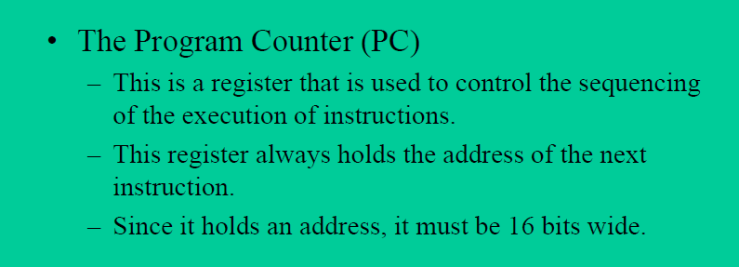
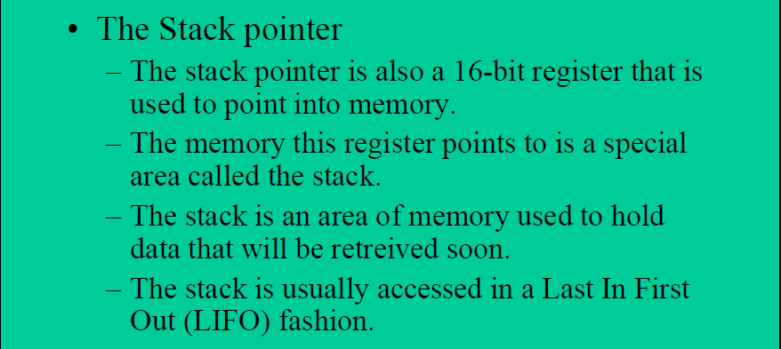

Slide 36
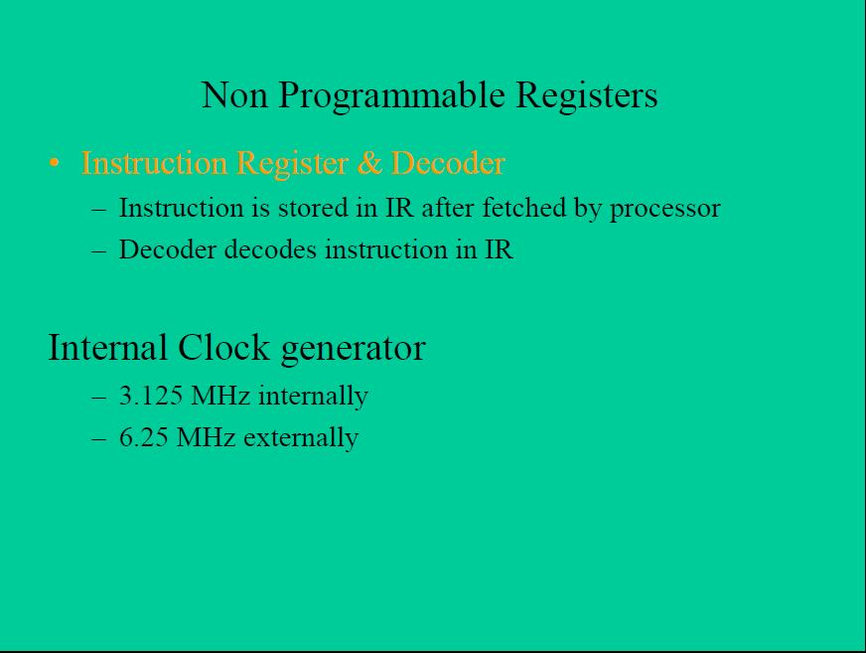

Slide 37
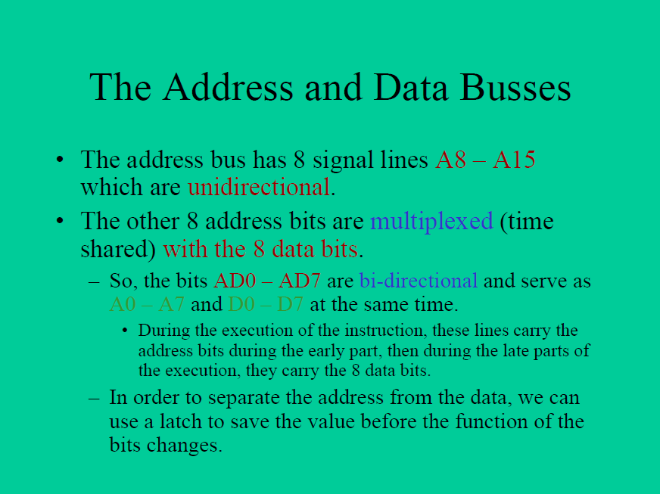

Slide 38
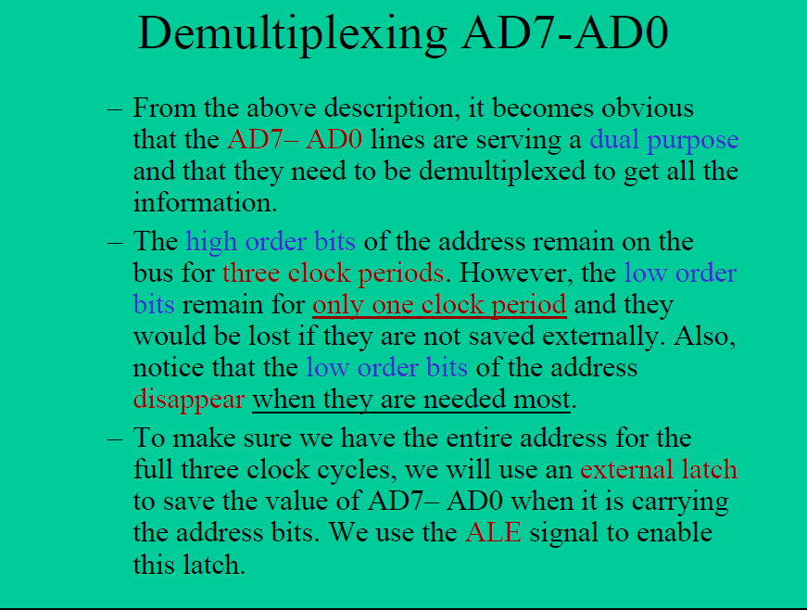

Slide 39
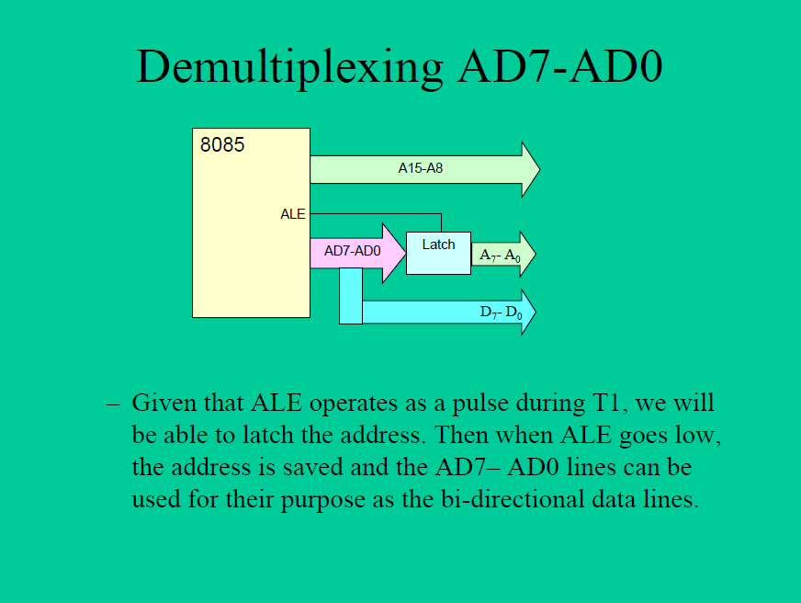

Slide 40
Timing Diagram is a graphical representation. It represents the execution time taken by each instruction in a graphical format. The execution time is represented in T-states.
Instruction Cycle:
The time required to execute an instruction .
Machine Cycle:
The time required to access the memory or input/output devices .
T-State:
The machine cycle and instruction cycle takes multiple clock periods.
A portion of an operation carried out in one system clock period is called as T-state.

Slide 41
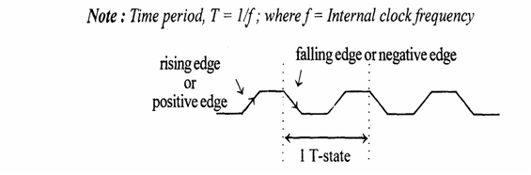

Slide 42
Timing diagrams
The 8085 microprocessor has 7 basic machine cycle. They are
1. Op-code Fetch cycle(4T or 6T).
2. Memory read cycle (3T)
3. Memory write cycle(3T)
4. I/O read cycle(3T)
5. I/O write cycle(3T)
6. Interrupt Acknowledge cycle(6T or 12T)
7. Bus idle cycle

Slide 43
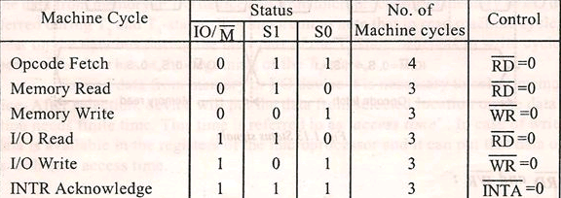

Slide 44
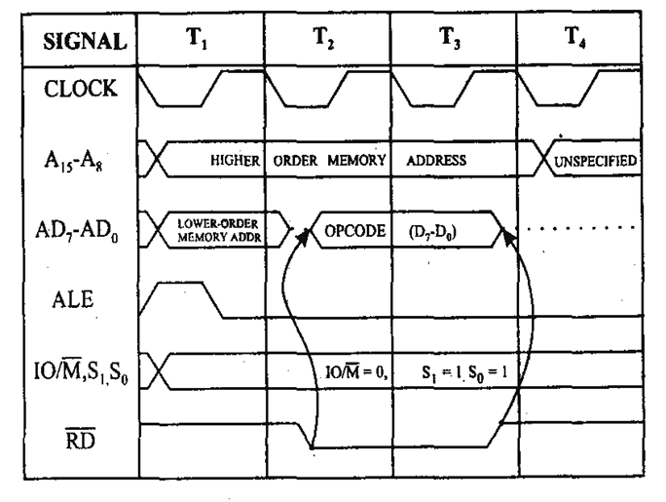
1.Opcode fetch cycle(4T or 6T)

Slide 45
OPCODE FETCH
The Opcode fetch cycle, fetches the instructions from memory and delivers it to the instruction register of the microprocessor
Opcode fetch machine cycle consists of 4 T-states.
T1 State:
During the T1 state, the contents of the program counter are placed on the 16 bit address bus. The higher order 8 bits are transferred to address bus (A8-A15) and lower order 8 bits are transferred to multiplexed A/D (AD0-AD7) bus.
ALE (address latch enable) signal goes high. As soon as ALE goes high, the memory latches the AD0-AD7 bus. At the middle of the T state the ALE goes low

Slide 46
T2 State:
During the beginning of this state, the RD’ signal goes low to enable memory. It is during this state, the selected memory location is placed on D0-D7 of the Address/Data multiplexed bus.
T3 State:
In the previous state the Opcode is placed in D0-D7 of the A/D bus. In this state of the cycle, the Opcode of the A/D bus is transferred to the instruction register of the microprocessor. Now the RD’ goes high after this action and thus disables the memory from A/D bus.
T4 State:
In this state the Opcode which was fetched from the memory is decoded.

Slide 47
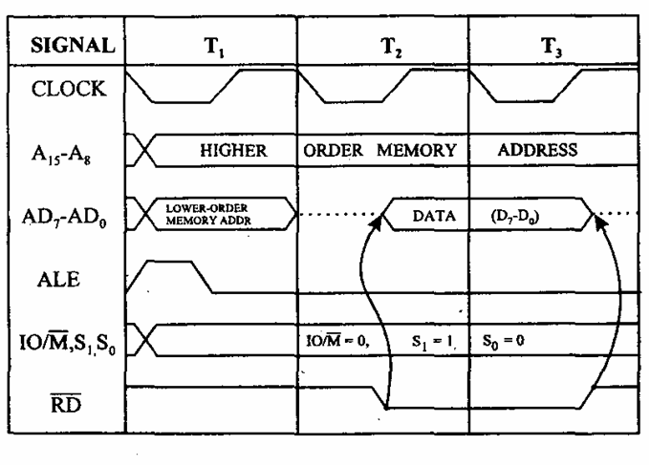
2. Memory read cycle (3T)

Slide 48
These machine cycles have 3 T-states.
T1 state:
The higher order address bus (A8-A15) and lower order address and data multiplexed (AD0-AD7) bus. ALE goes high so that the memory latches the (AD0-AD7) so that complete 16-bit address are available.
The mp identifies the memory read machine cycle from the status signals IO/M’=0, S1=1, S0=0. This condition indicates the memory read cycle.
T2 state:
Selected memory location is placed on the (D0-D7) of the A/D multiplexed bus. RD’ goes LOW
T3 State:
The data which was loaded on the previous state is transferred to the microprocessor. In the middle of the T3 state RD’ goes high and disables the memory read operation. The data which was obtained from the memory is then decoded.

Slide 49
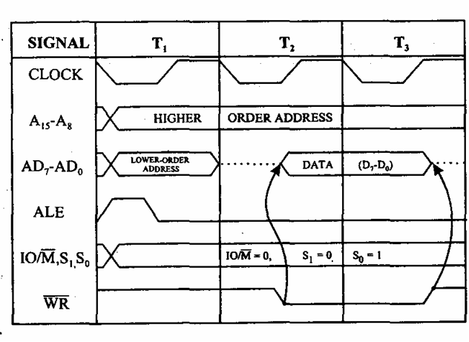
3. Memory write cycle (3T)

Slide 50
These machine cycles have 3 T-states.
T1 state:
The higher order address bus (A8-A15) and lower order address and data multiplexed (AD0-AD7) bus. ALE goes high so that the memory latches the (AD0-AD7) so that complete 16-bit address are available.
The mp identifies the memory read machine cycle from the status signals IO/M’=0, S1=0, S0=1. This condition indicates the memory read cycle.
T2 state:
Selected memory location is placed on the (D0-D7) of the A/D multiplexed bus. WR’ goes LOW
T3 State:
In the middle of the T3 state WR’ goes high and disables the memory write operation. The data which was obtained from the memory is then decoded.

Slide 51
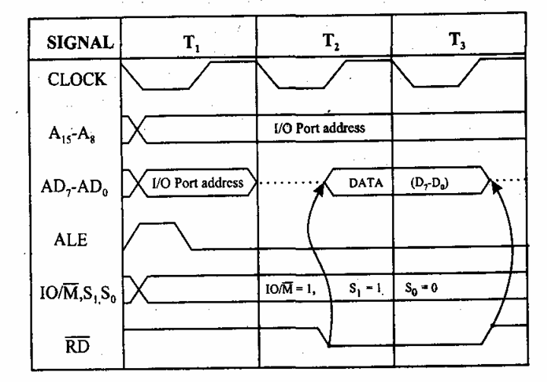
4.I/O read cycle(3T)

Slide 52
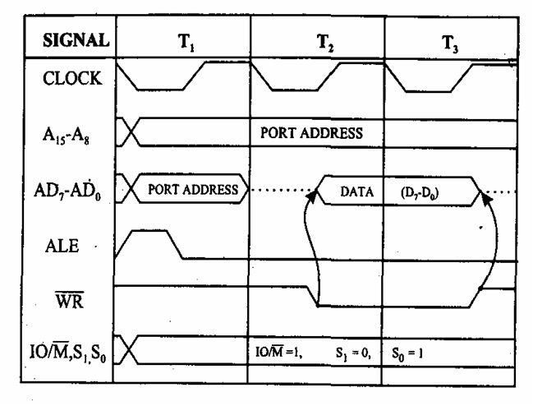
5.I/O write cycle(3T)

Slide 53
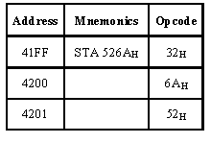
STA instruction ex: STA 526A

Slide 54
It require 4 m/c cycles 13 T states 1.opcode fetch(4T) 2.memory read(3T) 3.memory read(3T) 4.Memory write(3T)

Slide 55
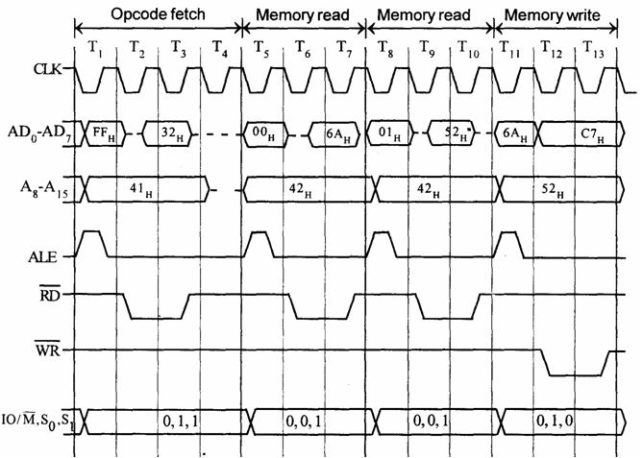

Slide 56
Timing diagram for IN C0H
Fetching the Opcode DBH from the memory 4125H.
Read the port address C0H from 4126H.
Read the content of port C0H and send it to the accumulator.
Let the content of port is 5EH.

Slide 57
It require 3 m/c cycles 10 T states opcode fetch(4T) memory read(3T) I/O read(3T)

Slide 58
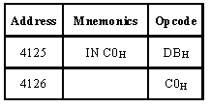

Slide 59
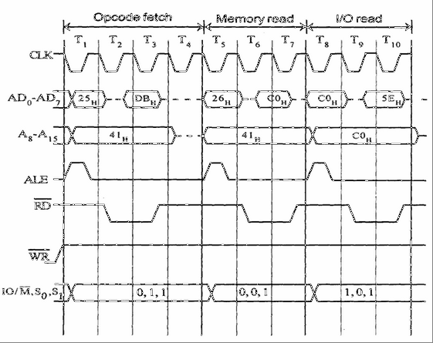
IN Byte

Slide 60
OUT instruction Machines Cycles(10T): 1.instruction fetch(4T) 2.memory read (3T) 3.IO write (3T)

Slide 61
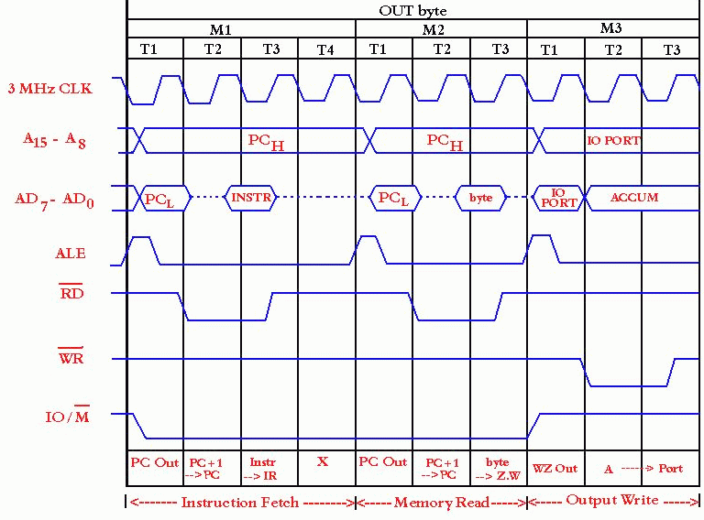

Slide 62
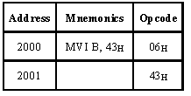
Timing diagram for MVI B, 43h
Fetching the Opcode 06H from the memory 2000H. (OF machine cycle)
Read (move) the data 43H from memory 2001H. (memory read)

Slide 63
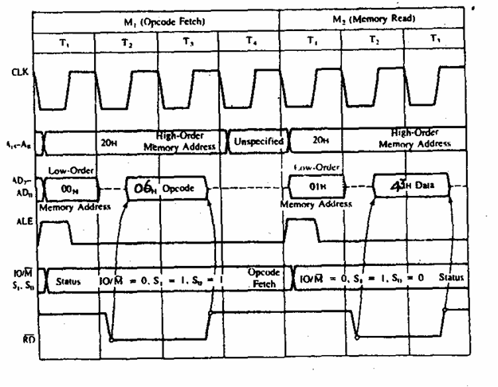

Slide 64
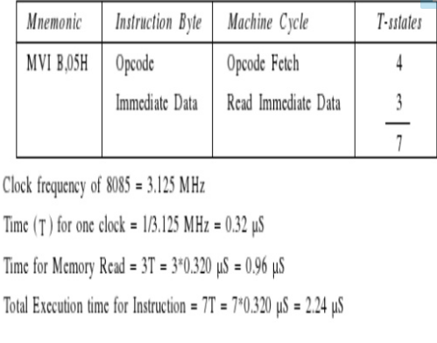

Slide 65
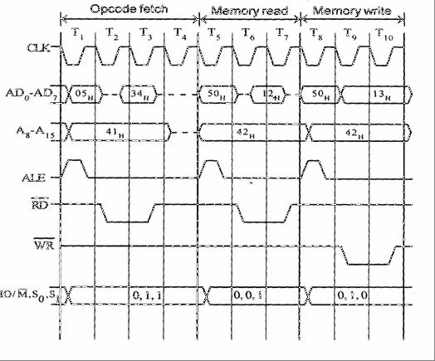
INR M

Slide 66
Timing diagram for INR M
Fetching the Opcode 34H from the memory.
Let the memory address (M) be 4250H. (MR cycle -To read Memory address and data)
Let the content of that memory is 12H.
Increment the memory content from 12H to 13H. (MW machine cycle)

Slide 67
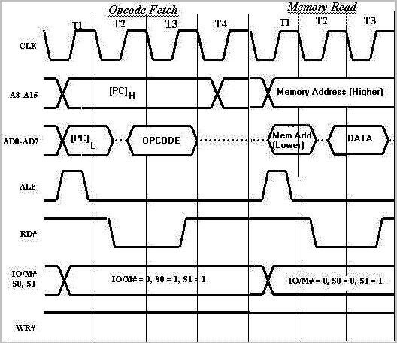
ADD M

Slide 68
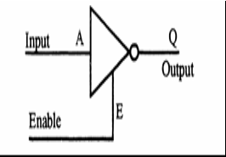
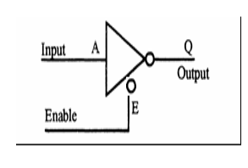
Tri-State Devices
Interfacing Device necessary to interconnect the components of bus-oriented system.
Devices essential for proper functioning of bus-oriented system.
have 3 states : logic 1, logic 0, and high impedance.
Trademark of National Semiconductor.
It is a useful device that allows us to control when current passes through the device, and when it doesn't.
Third line is called Enable is activated, tri-state device function same as ordinary logic device.

Slide 69
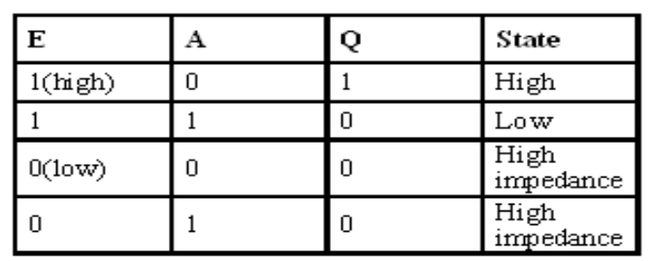
Tri-State Devices
When enable E is high the gate is enabled and the output Q can be 1 or 0 (if A is 0, Q is 1, otherwise Q is 0). However, when E is low the gate is disabled and the output Q enters into a high impedance state.

Slide 70
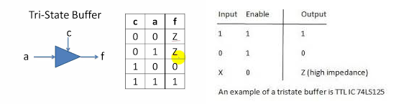

Slide 71
Instruction size
An instruction is assembled in the memory of a microcomputer system in binary form. The size of an instruction signifies how much memory space is required to load an instruction in the memory. 8085 instructions are of following sizes:
One-byte Instructions
e.g. MOV, ADD, ANA, SUB, ORA etc.
Two-byte instructions
e.g. MVI, ADI, ANI, ORI, XRI etc.
Three-byte instructions
e.g. LXI, LDA, STA, LHLD, SHLD etc.

Slide 72
Applications of Microprocessor
Microprocessor is a multi-use device which finds applications in almost all the
fields. Here is some sample applications given in variety of fields.
Electronics:
Digital clocks & Watches
Mobile phones
Measuring Meters
Mechanical:
Automobiles
Lathes
All remote machines
Electrical:
Motors
Lighting controls
Power stations

Slide 73
Applications of Microprocessor
Medical:
Patient monitoring
Most of the Medical equipments
Data loggers
Computer:
All computer accessories
Laptops & Modems
Scanners & Printers
Domestic:
Microwave Ovens
Television/CD/DVD players
Washing Machines

